Slide 1
Engaging Initial Teacher Trainee (ITT) students in Co-creating curricular that embed equality and diversity (pre and post entry to the ITT programme)
Presented by : Maxwell Ayamba, Jenson Grant and Maxine Greaves MBE

Slide 2
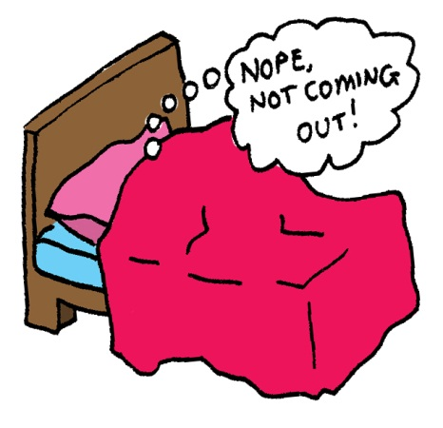
Stimulus
"Education is about the students constructing their own knowledge ..... Self belief is supported as a key attribute in motivation "
Yorke and Knight (2004)

Slide 3
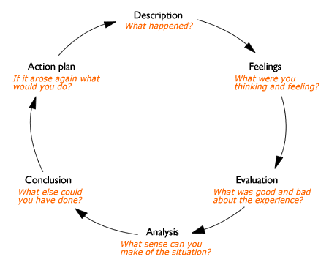
Reflection: Gibbs (1988)

